Slide 1
PYTHON PROGRAMMING FOUNDATIONS
Introduction to Python
What it is, why it matters, and how to run your first program.
Python 3 Fundamentals
13 Interactive Modules

Slide 2




OVERVIEW
What is Python?
High-Level Language
Created in 1991
Free & Open Source
Cross-Platform
Designed by Guido van Rossum as a successor to the ABC language with clean syntax.
Backed by a massive worldwide open-source community and rich ecosystem.
Runs seamlessly across Windows, macOS, Linux, and embedded hardware.
General-purpose language designed for supreme code readability and developer efficiency.

Slide 3
DOMAINS
Where Python is Used
Web Development
Data Analysis
AI & Machine Learning
Automation & Testing
Django, Flask, FastAPI
pandas, NumPy, Matplotlib
PyTorch, TensorFlow
Scripting, Scientific Computing
One versatile language powering modern software engineering across every major industry.

Slide 4




ADVANTAGES
Why Python is Popular
Top-Ranked Worldwide
Short Learning Curve
Consistently #1 on TIOBE and Stack Overflow surveys.
Minimal syntax overhead makes it ideal for beginners.
Readable Syntax
Huge Job Market
Clean, expressive syntax that reads almost like plain English.
Unmatched employer demand across tech startups and enterprise.

Slide 5
VERSION COMPARISON
Python 2 vs Python 3
Feature / Concept | Python 2 | Python 3
Status | End of life (2020) | Active & Current standard
print Statement | print "hi" | print("hi")
Division (7 / 2) | 3 (Integer division) | 3.5 (Float division)
Input Method | raw_input() | input()
Rule of Thumb: Learn Python 3 only. Python 2 is obsolete.

Slide 6
LANGUAGE ARCHITECTURE
Key Features of Python
Easy to Learn
High-Level
Interpreted
Intuitive syntax focusing on human readability.
Abstracts away hardware memory management.
Executes code line-by-line without manual compilation.
Dynamically Typed
Object-Oriented
Standard Library
Variables bind automatically without explicit type labels.
Treats data structures and functions as unified objects.
Batteries-included modules built directly into Python.

Slide 7
ENVIRONMENT
Setup in 3 Steps
1
2
3
Install Python
Verify Installation
Configure IDE
Download from python.org. Ensure you tick .
Open your terminal and check installation via command:
Install VS Code along with the official Microsoft Python Extension.
Add Python to PATH
python --version

Slide 8
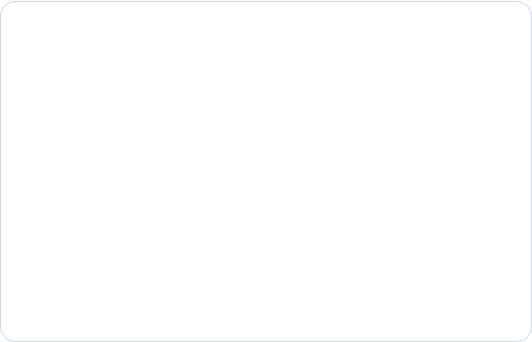
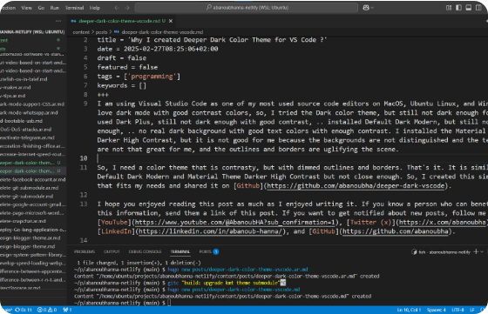
HANDS-ON
Your First Program
hello.py
Python 3
print("Hello, World!")
Run Command
Execute in terminal:
python hello.py

Slide 9
SYNTAX DEEP DIVE
Understanding print()
Output Flexibility
Control Arguments
f-Strings
Outputs text, numeric variables, or multiple arguments separated by commas.
sep= sets argument separators, while end= customizes line endings.
Clean inline string interpolation replacing legacy string concatenation.
print("Score:", 95)
print("Score:", 95)
print("A", "B", sep="-")
print("A", "B", sep="-")
print(f"{name} is {age}")
print(f"{name} is {age}")

Slide 10
EXECUTION PIPELINE
How Python Runs Your Code
STEP 1
STEP 2
STEP 3
STEP 4
Read
Check Syntax
Translate
Execute
Source file loaded
Verifies code structure
Compiles to bytecode
PVM runs bytecode
1. VS Code Runner
2. Command Line
3. Interactive REPL
Play button or
Run then enter
Ctrl+F5
python filename.py
python
>>>

Slide 11
EXERCISE
Practice Task
Write Your First Script
Create a file named that outputs your personal details using formatted print() statements.
about_me.py
Name: Alex Chen University: Stanford University Fav Language: Python Intro: Learning Python to build AI models!
Expected Output Example
Name: Alex Chen University: Stanford University Fav Language: Python Intro: Learning Python to build AI models!
Your Name
Your University
Your Favourite Programming Language
A Short Self-Introduction

Slide 12




SUMMARY
Key Takeaways
Readable & Everywhere
Python 3 Standard
Quick Setup
Start with print()
Always use Python 3. Python 2 reached end-of-life and is obsolete.
Install Python, check PATH, pair with VS Code, and start coding instantly.
The fundamental starting point for every program and developer journey.
Python is clean, open source, and used across tech, data science, and AI.

Slide 13


Questions & Answers
Thank you for participating! What would you like to build with Python?
Next Up: Variables, Data Types & Control Flow

